Slide 1
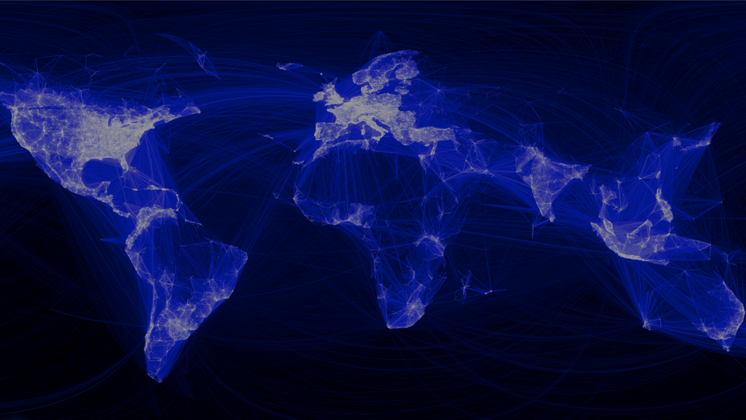
Internet of Things

Slide 2
Umgebung
Internet
Things

Slide 3
Umgebung
Internet
Things
Internet of Things

Slide 4



Slide 5





Slide 6
The most profound technologies are those that disappear. They weave themselves into the fabric of everyday life until they are indistinguishable from it.
Mark Weiser, 1991, The Computer for the 21st Century

Slide 7
Quellen
https://www.ics.uci.edu/~corps/phaseii/Weiser-Computer21stCentury-SciAm.pdf
https://www.facebook.com/notes/facebook-engineering/visualizing-friendships/469716398919/
https://de.wikipedia.org/wiki/Internet_der_Dinge

